Slide 1
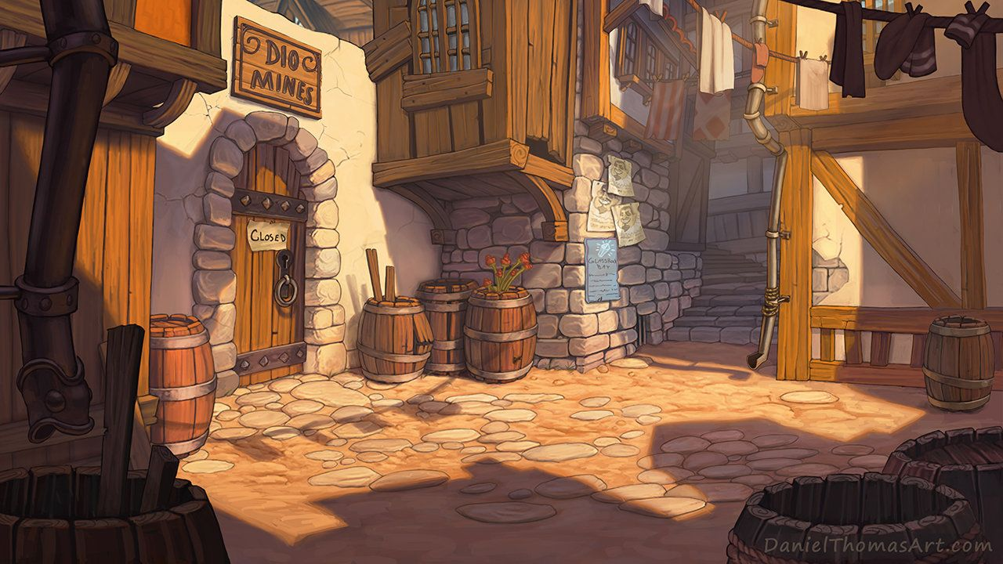

Slide 10
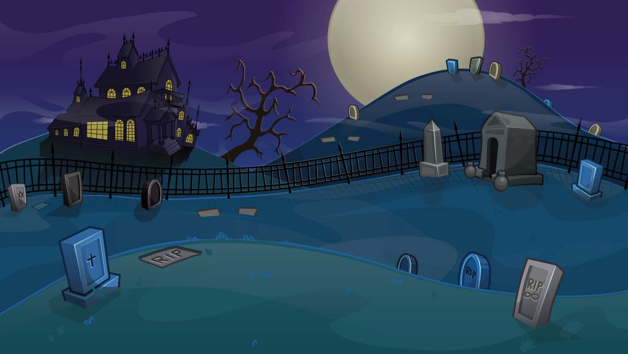
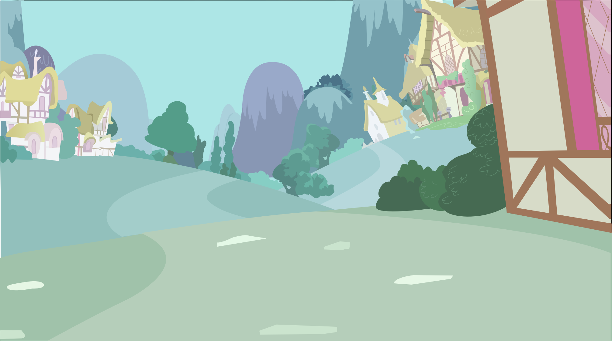
Text review
3 letters
9 letters
2 letters
1 letter
5 letters
7 letters
10 letters
14 letters
13 letters
12 letters
6 letters
4 letters
11 letters
8 letters
Insert answer
Vowels
How many letters?
a
e
i
o
u
1
2
3
4
5
6
7
Consonants
8
9
10
11
12
13
14
b
c
d
f
g
h
j
Background
k
l
m
n
p
q
r
START
s
t
v
w
x
y
z

Slide 11
Picture review
3 letters
9 letters
2 letters
1 letter
5 letters
7 letters
10 letters
14 letters
13 letters
12 letters
6 letters
4 letters
11 letters
8 letters
Insert answer
Vowels
How many letters?
a
e
i
o
u
1
2
3
4
5
6
7
Consonants
8
9
10
11
12
13
14
b
c
d
f
g
h
j
Background
k
l
m
n
p
q
r
START
s
t
v
w
x
y
z

Slide 12
Blank template
3 letters
9 letters
2 letters
1 letter
5 letters
7 letters
10 letters
14 letters
13 letters
12 letters
6 letters
4 letters
11 letters
8 letters
Vowels
How many letters?
a
e
i
o
u
1
2
3
4
5
6
7
Consonants
8
9
10
11
12
13
14
b
c
d
f
g
h
j
Background
k
l
m
n
p
q
r
START
s
t
v
w
x
y
z

